Slide 1
Unit 6
ExceptionHandling

Slide 2
Exceptions
One of the advantages of C++ over C is Exception Handling.
Exceptions are runtime anomalies or abnormal conditions that a program encounters during its execution.
There are two types of exceptions:
a)Synchronous, (found in programlogic)
b)Asynchronous (i.e., exceptions which are beyond the program’s control, such as disc failure, keyboard interrupts etc.).
C++ provides the following specialized keywords for this purpose:
try: Represents a block of code that can throw an exception.
catch: Represents a block of code that is executed when a particular exception is thrown.
throw: Used to throw an exception. Also used to list the exceptions that a function throws but doesn’t handle itself.

Slide 3
Syntax
try {
// protected code
throw
} catch( ExceptionName e1 ) {
// catch block
} catch( ExceptionName e2 ) {
// catch block
} catch( ExceptionName eN ) {
// catch block
}
The try statement allows you to define a block of code to be tested for errors while it is being executed.
The throw keyword throws an exception when a problem is detected, which lets us create a custom error.
The catch statement allows you to define a block of code to be executed if an error occurs in the try block.

Slide 4
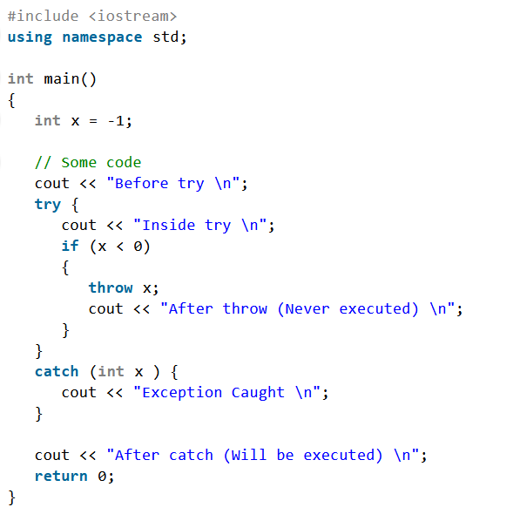
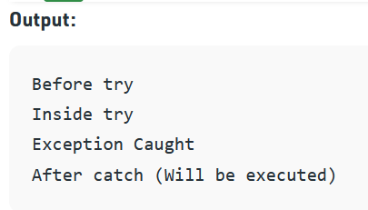

Slide 5
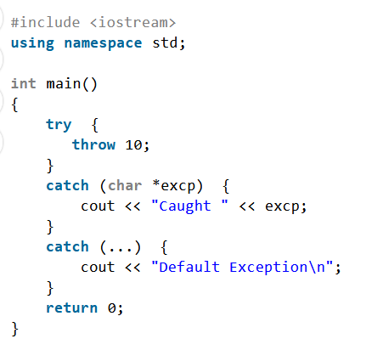
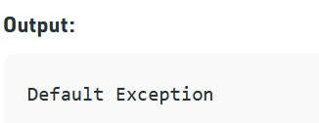

Slide 6
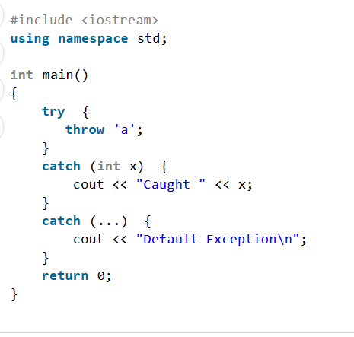

Slide 7
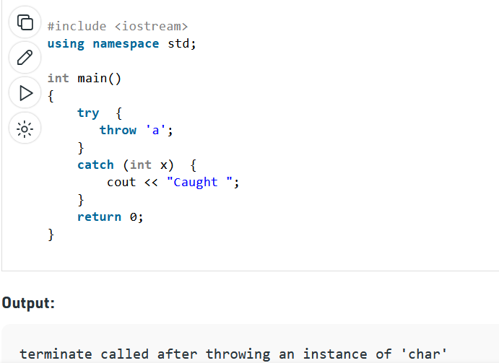

Slide 8
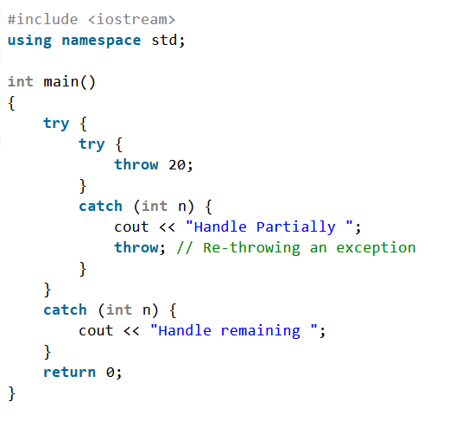

Slide 9
